Slide 1
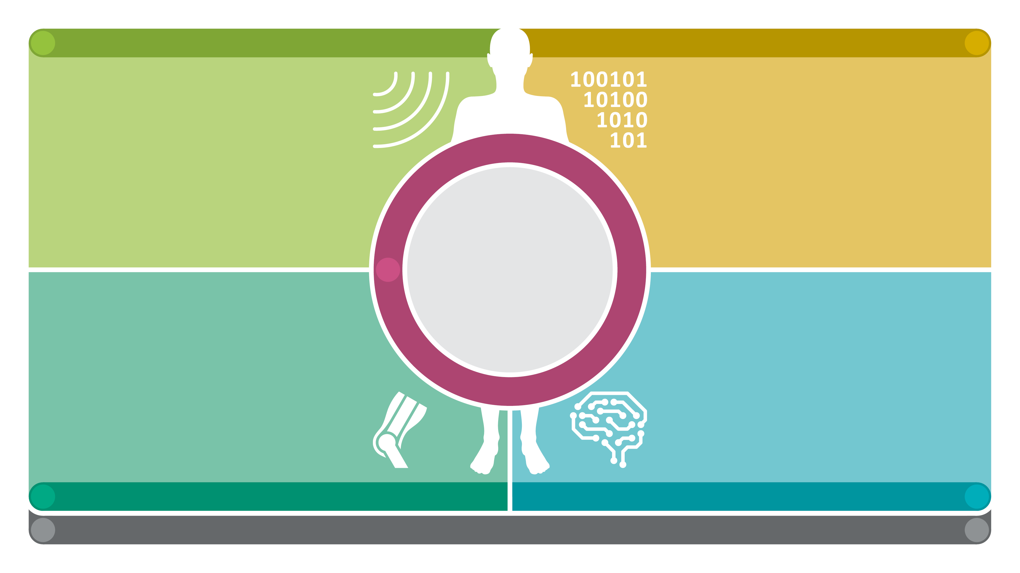
A
CONTACTLESS SENSORS FOR RECORDING MOTION PARAMETERS AND VITAL FUNCTIONS
SENSOR SIGNAL/DATA PROCESSING AND TRANSFER
B
Multimodal 3D Body Imaging Camera [Stamminger – LGDV, Vossiek – LHFT]
Holographic 6D Wireless Locating and Motion Tracking [Vossiek – LHFT]
Highly Integrated Localizable Wireless EMG Transponder [Hagelauer – MNT,TUM, Weigel – LTE]
Microwave Interferometer for Cardiovascular and Respiratory Monitoring [Kölpin – IHF, TUHH]
Electro-optic Microstructure- and Micromotion-Senso
[Schmauß, Carlowitz – LHFT]
Coding of Multimodal Body Hull Data
[Kaup – LMS]
Protocols and Algorithms for Energy-efficient Reference Signal and EMG Sensor Data Transmission Integrating Local Energy Harvesting
[Schober – IDC]
Compressive Sensing for Empathokinaesthetic Radar Sensors
[Müller – IDC]
Visualization of Motion Sequences Based on a Biomechanical Model [Stamminger – LGDV, Winkler – MN]
[Dabrock, Braun – Ethik]
ETHICS IN AND BY DESIGN
EMPATHO-
KINÄSTHETISCHES
LAB
E
Machine Learning for Personalization of Musculoskeletal Models, Movement Analy-sis, and Movement Predictions [Koelewijn – MaD]
Filtering of Multimodal Motion Capture Data through Individualized Musculoskeletal Human Models [Wartzack, Miehling – KTmfk]
Investigation of Postural Control using Sensomotorically Extended Musculoskeletal Human Models [Wartzack, Miehling – KTmfk, Winkler, Eskofier – MaD]
Analysis of Degenerative Motion Impairments through Integration of Empa-thokinaesthetic Sensor Data in Biomechanical Human Models
[Leyendecker – LTD]
Hand Motion Patterns Derived from Empathokinaesthetic Sensor Data as a Diagnostic Parameter for Disease Activity in Patients with Rheumatic Diseases [Liphardt, Schett – Med3]
Empathokinaesthetic Sensor Technology for Biofeedback in Depressed Patients [Berking - KliPs, Eskofier – MaD]
Contact-free Measurement of Stress, its Determinants and Consequences [Rohleder – GESPSY]
Sensor-based Movement and Sleep Analysis in Parkinson's Disease [Winkler – MN, Eskofier – MaD]
Empathokinaesthetic Assessment and Pattern Recognition of Movement as Biomarkers for Health Status, Wellbeing and Prognosis of Palliative Patients [Ostgathe – PALL]
C
BIOMECHANICAL MODELING AND CONDITION MONITORING
PHYSIOLOGICAL AND BEHAVIORAL MODELING AND CONDITION MONITORING
D
Z
CENTRAL TASKS OF THE COLLABORATIVE RESEARCH CENTRE [Vossiek – LHFT]
INTEGRATED RESEARCH TRAINING GROUP [ Eskofier – MaD]
G

Slide 2
